Slide 1


Green Pace
Security Policy Presentation
Developer: Chloe Ninefeldt

Slide 2

OVERVIEW: DEFENSE IN DEPTH
Multi-layer security, also known as Defense in Depth (DiD)
Notes:
There are many layers to defense in depth, each layer doing their part to protect the sensitive information and be a failsafe incase one layer fails. However, there are only so many layers one can have where it gets a bit too chaotic. Having too many layers can be costly, and the maintenance can be a bit much. The layers will vary depending on the company, but it is wise to have a good defensive system. With the world we live in today, technology is advancing, and hackers are getting smarter which means we need to think of better defensive strategies. This diagram show different layers and different ways to protect your system. Find one that works well with the business and helps protect the company.

Slide 3
THREATS MATRIX
Likely These types of threats can potentially occur more frequently | Priority These types of risks need to be at the top of the list as far as action wise
Low priority These types of risks need to be on the list, but are not detrimental. | Unlikely These types of risks don’t tend to happen often, but can still occur.
Notes:
This is a threat matrix. In this matrix, threats are measured by how likely they are and their priority. Likely type of threats are threats that can occur more frequently, and unlikely is the opposite where they don’t occur often, but can still happen. Priority means that the threat needs to be at the top of the list to get fixed, whereas low priority is not detrimental, but still needs to be addressed.

Slide 4
10 PRINCIPLES
Validate Input Data
Heed Compiler Warnings
Architect and Design for Security Policies
Keep it Simple
Default Deny
Adhere to the Principle of Least Privilege
Sanitize Data Sent to Other Systems
Practice Defense in Depth
Use Effective Quality Assurance Techniques
Adopt a Secure Coding Standard
Notes:
These are the 10 principles of security that Green Pace should follow.

Slide 5
CODING STANDARDS
STD-002-CPP
STD-003-CPP
STD-005-CPP
STD-009-C
STD-001-CPP
STD-010-C
STD-004-CPP
STD-006-C
STD-007-CPP
STD-008-CPP
Rule | Severity | Likelihood | Remediation Cost | Priority | Level
STD-001-CPP | Medium | Unlikely | Medium | P4 | L3
STD-002-CPP | High | Likely | Medium | P18 | L1
STD-003-CPP | High | Likely | Medium | P18 | L1
STD-004-CPP | Low | Likely | Low | P9 | L2
STD-005-CPP | High | Likely | Medium | P18 | L1
STD-006-C | Low | Unlikely | High | P1 | L3
STD-007-CPP | Low | Likely | Low | P9 | L2
STD-008-CPP | Low | Probable | High | P2 | L3
STD-009-C | High | Probable | Medium | P12 | L1
STD-010-C | Medium | Probable | High | P4 | L3
Notes:
Here are 10 coding standards ranked from the highest severity to the lowest, as the severe standards need to be addressed as soon as possible. I have also put in the table to show you what the severity, the likelihood, the remediation cost, priority and levels are to get a better picture of where we are at.

Slide 6
ENCRYPTION POLICIES
In Rest:
This is where data is being encrypted while the data is being stored. Where unauthorized users cannot decrypt it and thus preventing the data from falling into the wrong hands. It’s converting the data into another form of data through an algorithm that can only be understood by a person who has the key in order to decode it. This policy applies because it helps protect the data in the system. Helping defend from hackers getting their hands on sensitive information of customers and/or the company.
At Flight:
This is where data is being encrypted while it is transmitting over the network. This helps prevent getting data stolen over the network. Each side, sender and receiver (if authorized) will have an encryption key that is unique so that once they have the data, it can be de-encrypted. This policy applies because it helps from preventing transmitting data stolen.
In Use:
Data that is either at rest, in use, or in transit will never be left unsecured. It does not matter where it is being stored but the sensitive data will always be protected. This policy applies in order to keep sensitive data, regardless on what it is doing (at rest, transmitting, or being used) is always secured to assure the customers, partners, etc. that their information is safe.
Notes:
Script on slide.

Slide 7
TRIPLE-A POLICIES
Authentication:
Authentication is necessary to provide the business a way to allow certain users to access the system. This can be done using a user ID, password, and possibly a biometric signature. This policy applies because it prevents unauthorized users out of the system and accessing data.
Authorization:
Authorization is needed to grant access/rights for the authenticated users. This allows for limiting users from accessing information that they do not need, and also granting users to accessing information they do need. Data that is being accessed by too many users when only a few should be accessing it can make the data less secured.
Accounting:
Accounting is basically a checks and balances for a business. Making sure the system is being monitored and being aware of the data that is being used. It also helps with authentication and authorization to see who has what capabilities and if they should keep said capabilities. It can help in preventing data getting into the wrong hands.
Notes:
Script on slide.

Slide 8
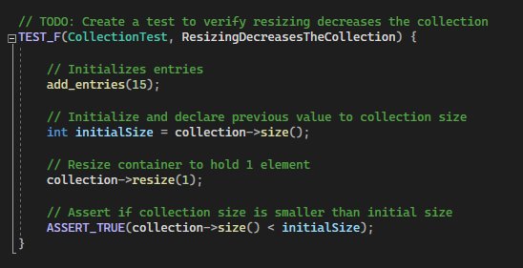
Unit Testing
Test to verify resizing decreases the collection

Slide 9
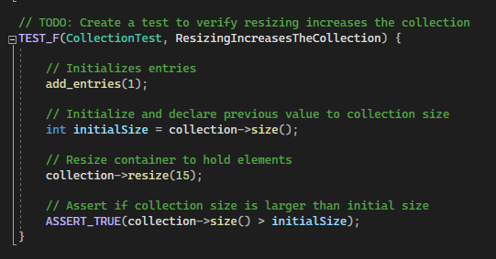
Unit Testing
Test to verify resizing increases the collection

Slide 10
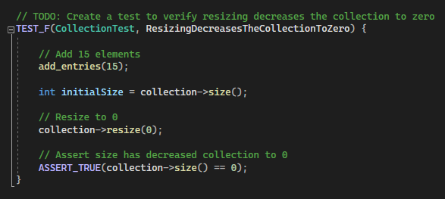
Unit Testing
Test to verify resizing decreases the collection to zero

Slide 11
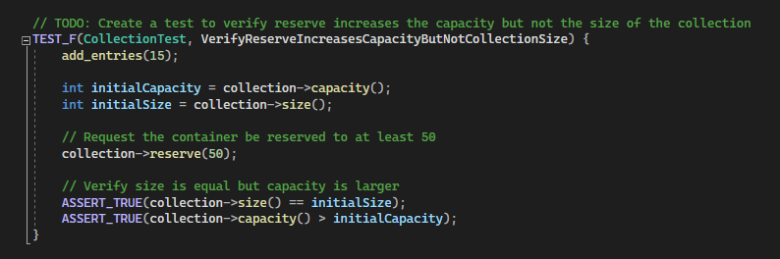
Unit Testing
Test to verify reserve increases the capacity but not the size of the collection.

Slide 12
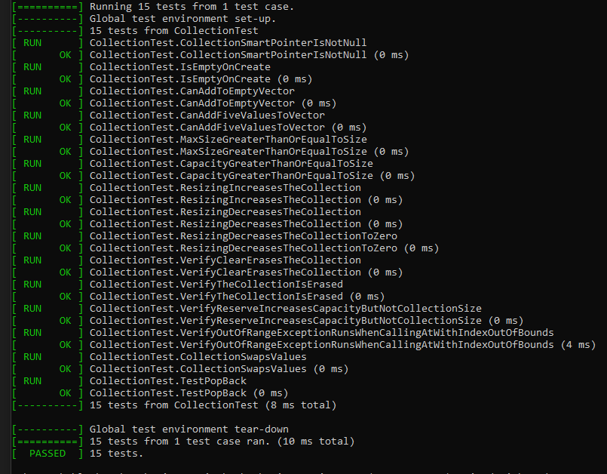
Unit Testing
All tests passed.

Slide 13

AUTOMATION SUMMARY
Notes:
Automation will be used for the enforcement of and compliance to the standards defined in this policy.

Slide 14
TOOLS
DevSecOps is where security is integrated into your software development life cycle. In order to build, test, and deploy secure software faster, there needs to be some security practices put in place. This helps with detecting security vulnerabilities in the early stages and a faster recovery speed if a security incident were to occur (Foster, 2021).
An external tool that can be used is cppchecker. This tool can go line by line of the warnings/messages that need to be addressed. In my experience, cppchecker caught more issues than Visual Studios did. In a coding project, Visual Studios marked 2 lines with errors, while cppchecker marker over 15 lines. This can help fix and secure code.
Notes:
Script on slide.

Slide 15
RISKS AND BENEFITS
Acting now:
It takes a lot of time doing all of these tests and making sure it’s secure. Due to increased time testing, this could delay the project.
If the project is secure though and following the security policies and practices, threats can be caught early rather than in production. Fixing a project in production can cost time and money depending on the damages.
Acting later:
Waiting till later can make the code not consistent and editing the code later can be costly with adding security features.
It makes development faster.
Notes:
There are some risks and benefits when it comes to adding security features to your project.

Slide 16
RECOMMENDATIONS
Follow security standards
Defense in Depth (DiD)
Triple A Policies
Encryption Policies
Notes:
Add security features in the beginning and always follow security standards. I also recommend having defense in depth, triple A policies, and encryption policies.

Slide 17
CONCLUSIONS
Our world has advanced so far in technology and we continue to keep advancing. With these advancements comes vulnerabilities as we learn what updates do what to systems. Hackers are also getting smarter and finding new ways to breach a system. Following the security standard practices: the ten principles, triple A policies, encryption policies, will all help in protecting the system. Unfortunately, one can’t catch everything, even if Green Pace followed this Security Policy 100%, there will always be one tiny thing that gets looked over and that is expected. That is why there is Defense in Depth, testing, and procedures to follow if anything were to occur. Everyone, from the CEO and down, will need to follow this security policy for the best outcome.

Slide 18
REFERENCES
Das, P. (2022, May 11). In-use encryption – what it is and how companies benefit. Sotero. Retrieved June 8, 2022, from https://www.soterosoft.com/blog/data-in-use-encryption-data-in-motion-encryption/#:~:text=In%2DUse%20encryption%20takes%20a,%2C%20cloud%2C%20or%20hybrid
Dunham, R. (2020, May 5). The importance of a company information security policy. Linford & Company LLP. Retrieved June 12, 2022, from https://linfordco.com/blog/information-security-policies/
Model, I. (2017, May 17). What is encryption at rest, and why is it important for your business? Brightline Technologies. Retrieved June 8, 2022, from https://brightlineit.com/encryption-at-rest-important-business/
Shacklett, M. E. (2021, September 27). What is authentication? SearchSecurity. Retrieved June 12, 2022, from https://www.techtarget.com/searchsecurity/definition/authentication#:~:text=Authentication%20enables%20organizations%20to%20keep,network%2Dbased%20applications%20or%20services

